Slide 1


GAG – Employee Cash Advance
Solution Design Guide
Author | Steven Winoto
Creation Date | 3-Feb-2021
Last Update | -
Document Ref | -
Ver. | 1.0
Farida Osckar
Yanuar Nukhan Wijayanto
Notes:
https://system.netsuite.com/app/common/search/searchresults.nl?saverun=T&scrollid=2327&searchid=2327&refresh=&whence=

Slide 2

GAG – Employee Cash Advance
Notes:
https://system.netsuite.com/app/common/search/searchresults.nl?saverun=T&scrollid=2327&searchid=2327&refresh=&whence=

Slide 3
Requirement
GAG wants to maintain employee cash advance flow with:
Cash advance to Employee
Employee Reimbursement (without using Cash Advance No.)
Employee Settlement (with using Cash Advance No.)
Cash Advance Refund from Employee
Cash Advance Expired and Charge to Employee Payroll
For every settlement using Expense Report, there will be no approval.
User can’t submit settlement Cash Advance (Settlement, Refund from Employee and Charge to employee payroll) if submitted amount more than outstanding cash advance amount of selected cash advance number

Slide 4
Requirement
User can only create cash advance through write check transaction only using standard COA netsuite “Advances Paid” that will be edited to GAG COA “11330001 Other Receivables - Cash Advance”
If there is additional cash advance with same cash advance number, user can add additional cash advance after its created as long as edited amount is not less than Consumed amount.
There are two reports of cash advances, layout detail will be in the next slide

Slide 5
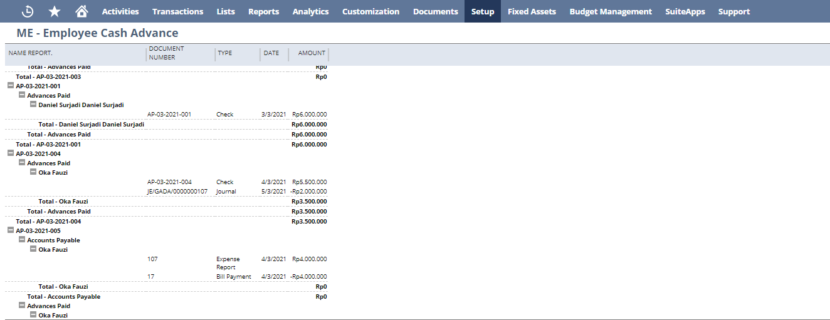
1st Report Layout (Employee Cash Advance per Cash Advance Number)

Slide 6
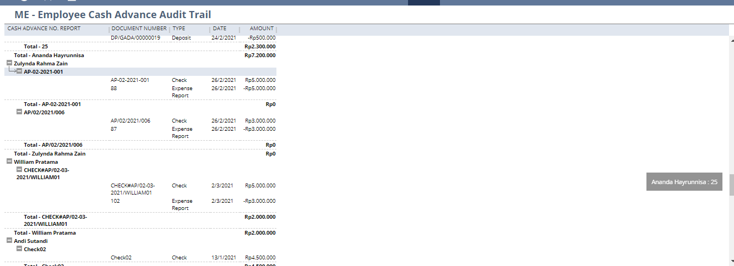
2nd Report Layout (Tracking COA Cash Advance Only per Employee)

Slide 7
Standard NetSuite Record for Employee Cash Advance

Slide 8
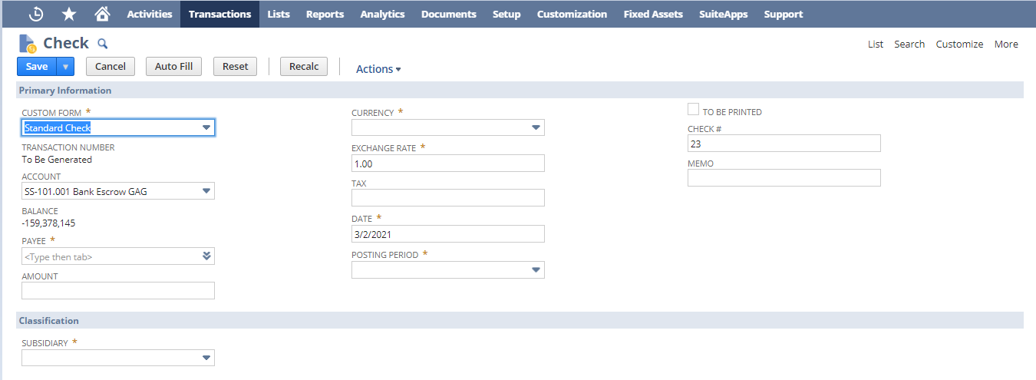
1. Write Check

Slide 9
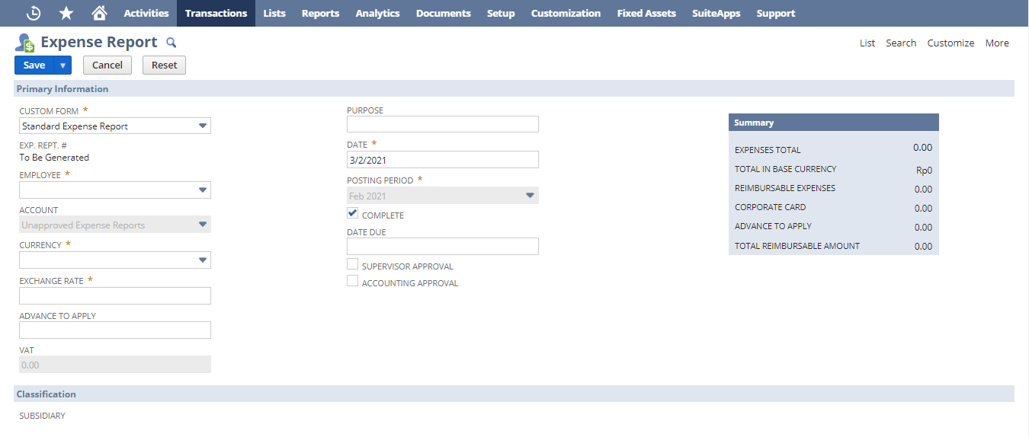
2. Expense Report

Slide 10
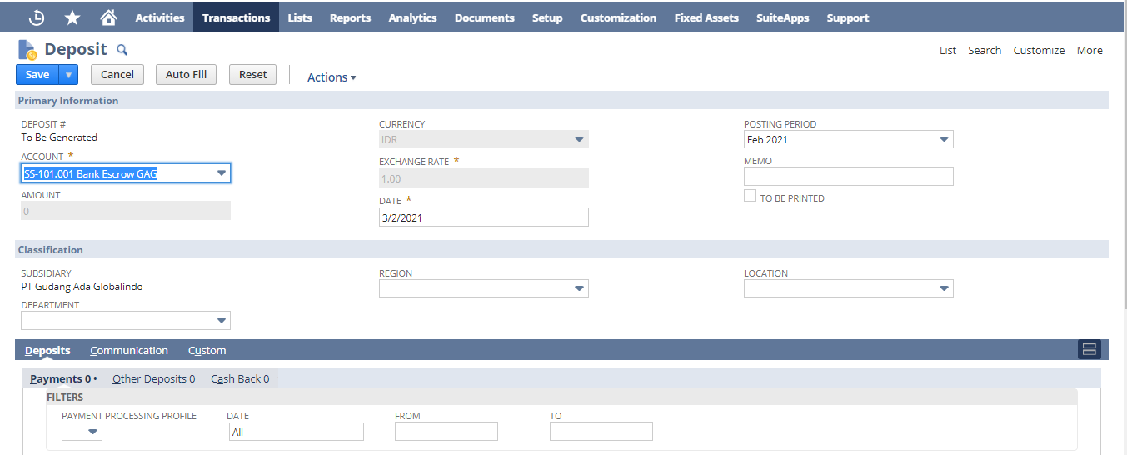
3. Deposit

Slide 11
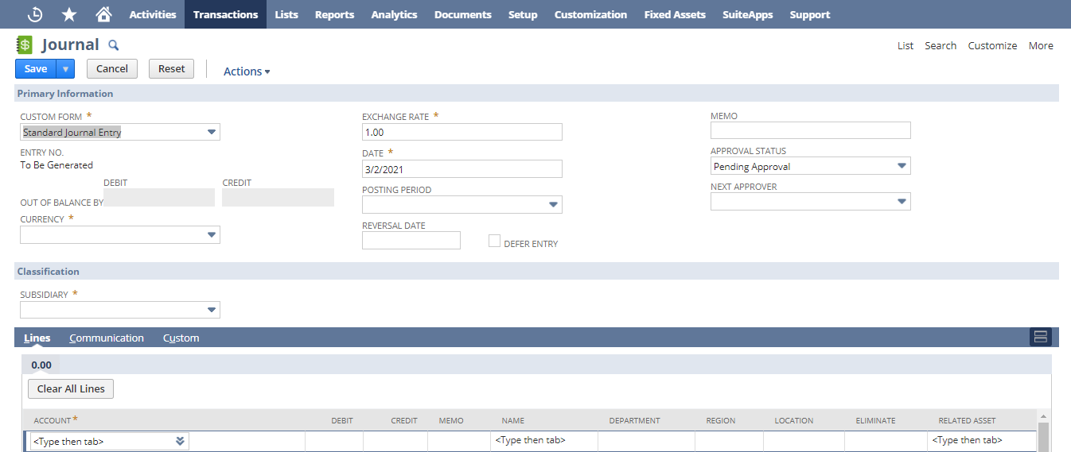
4. Journal Entry

Slide 12
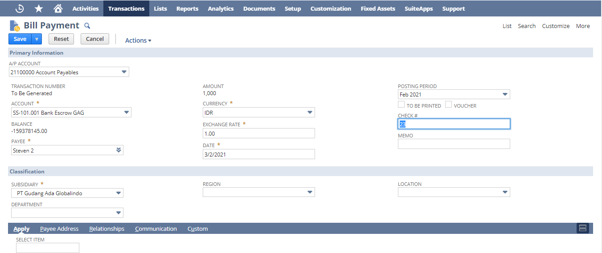
5. Vendor Payment

Slide 13
Requirement to SDG

Slide 14
Requirement
To Design Employee Cash advance flow like below:
Create new custom form for records:
Write Check : ME – Cash Advance
Expense Report : ME – Expense Report
Deposit : ME – Cash Advance Refund
Journal Entries : ME – Charge Cash Advance
Bill Payment : ME – Settlement Cash Advance
For every custom forms that already defined in number 1, add custom transaction body fields:
Named “Cash Advance No.” (except Write Check and bill payment), normal, filtered by transaction check, custom form ME – Cash Advance and outstanding amount greater than 0
Named “Cash Advance No.” (only Bill Payment), normal, filtered by transaction check, custom form ME – Cash Advance
Named “Cash Advance No. Report”, disable
Add transaction body fields “Total Advance” in ME – Cash Advance, ME – Expense Report, ME – Deposit and ME – Charge Cash Advance, display type = inline and value will be auto calculated based on Advances Paid COA only in these records.
Auto generate cash advance no. report based on selected cash advance no. (applied only to all custom forms that already defined in number 1), and remove/substring “Check #”
Ex : Cash Advance No. = Check # Advance 001, then Cash Advance No. Report is Advance 001

Slide 15
Requirement
Disable and Check Supervisor Approval, Accounting Approval, Complete fields on ME – Expense Report. (workflow)
Add transaction body fields in Write Check record only (in ME – Cash Advance Form):
“Consumed Advance”, disabled, formula = total advance – outstanding advance
“Outstanding Advance”, disabled, get amount value from saved search (sample can see “ME – Outstanding Cash Advance”)
For these selected form and record:
Write Check : ME – Cash Advance
Expense Report : ME – Expense Report
Deposit : ME – Deposit
Journal Entries : ME – Charge Cash Advance
Before these record and form (Show list above), is submitted, trigger to check:
If outstanding advance fields in Write Check amount of selected Cash Advance No. is < than total advance for every form (2 transactions above, EXCEPT ME-CASH ADVANCE, ME – EXPENSE REPORT), return user error “Outstanding advance must be greater or equal than total advance that your submitted”
If total advance fields in Write Check amount. is < than consumed advance fields (ONLY FOR ME-CASH ADVANCE), return user error “Total advance amount must be greater or equal than consumed advance amount”

Slide 16
Requirement
After these record and form (Show list above for 4 records), is submitted, trigger to update consumed advance and outstanding advance fields in write check record based on selected Cash Advance No. for all records except write check /CHECK # for Write Check.
Notes : Update after submit only for Journal when the state is approved
Add transaction body fields, named “Name Report”, display type = hidden (for reporting purposes) in (trigger on after submit), if form and records:
Write Check (ME – Cash Advance) = generated from Payee fields
Expense Report (ME – Expense Report) = generated from name report fields based on selected cash advance no.
Deposit : ME – Cash Advance Refund = generated from name report fields based on selected cash advance no.
Journal Entries : ME – Charge Cash Advance = generated from name report fields based on selected cash advance no.
Bill Payment : ME – Settlement Cash Advance = generated from name report fields based on selected cash advance no.
Before Expense Report (only using ME – Expense Report form) is submitted, if advance to apply fields > outstanding advance of selected cash advance no. then return user error “You can’t apply advance more than selected outstanding cash advance”

Slide 17
Requirement
Before Deposit and Journal (with their form) is saved, check amount, if total advance is < 0 then return user error “You can’t add advance amount through this transactions”
When user change cash advance no. in Deposit/Journal/Expense report then release previous selected cash advance no. and deduct latest selected cash advance no.
If Journal/Deposit/Expense Report is voided, then release outstanding amount based on selected cash advance no.
For opening balance purposes, update outstanding and total advance in Write Check record (only ME – CASH advance form) when data is imported using CSV.
Validate Check# must be unique

Slide 18
Notes
User who create item only given Create access, while approver will have only approve access. If created item is rejected, then user needs to create new requested item record.
Please advice the possibility to develop this prototype scenario and possibility to be demonstrated to customer
Please advice that other item transaction will not be impacted or I should provide separate demo account

